Slide 1
Relay based H Bridge
TEARCI T3
Julio filho
Tomás carvalho
Luís amorim

Slide 2
Summary
Intro
Physical assembly
Schematic assembly
Technical details
Final thoughts

Slide 3
INTRO
The H bridge

Slide 4

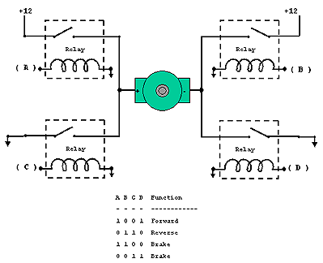
The beginning
Initially, we received an assignment to assemble an H-bridge for a motor, where we would be assembling our own relay shields.

Slide 5
Physical assembly
My first steps in the project

Slide 6
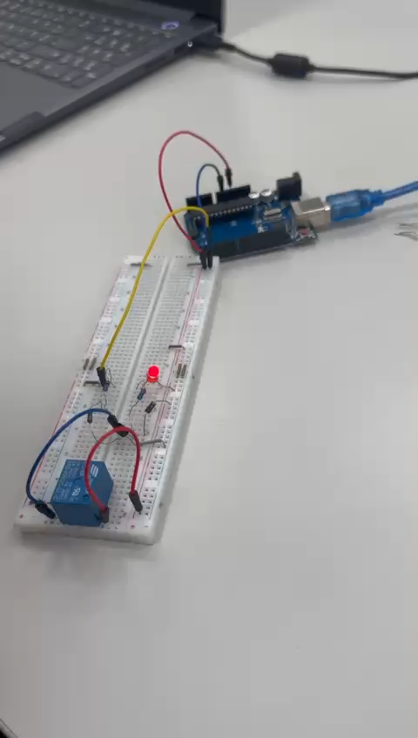
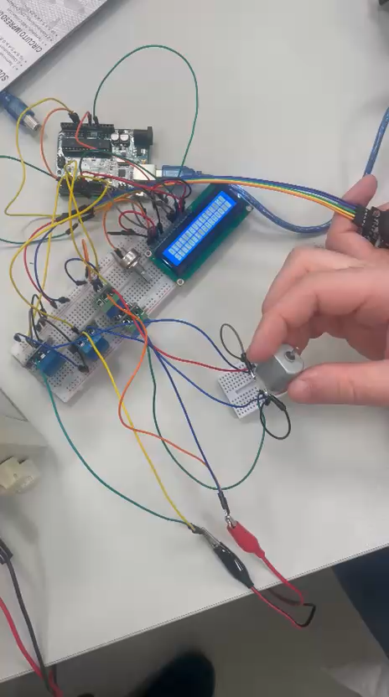
The relay Shield & H Bridge
My setup simulating the relay shield and its operation.
A simulation with 4 relays using pre-made optocouplers.

Slide 7
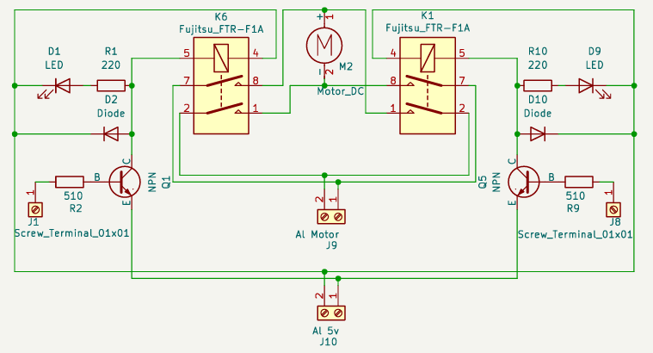
Schematic
Complete schematic with 2 shields with dual relays joined in a single H-bridge design.

Slide 8
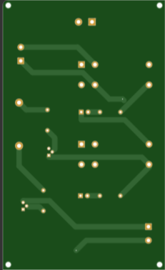
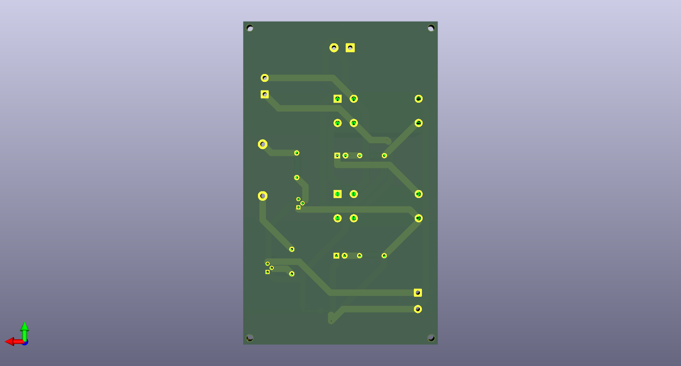
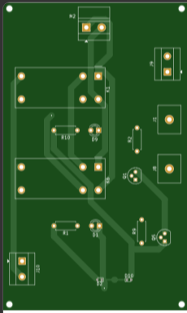
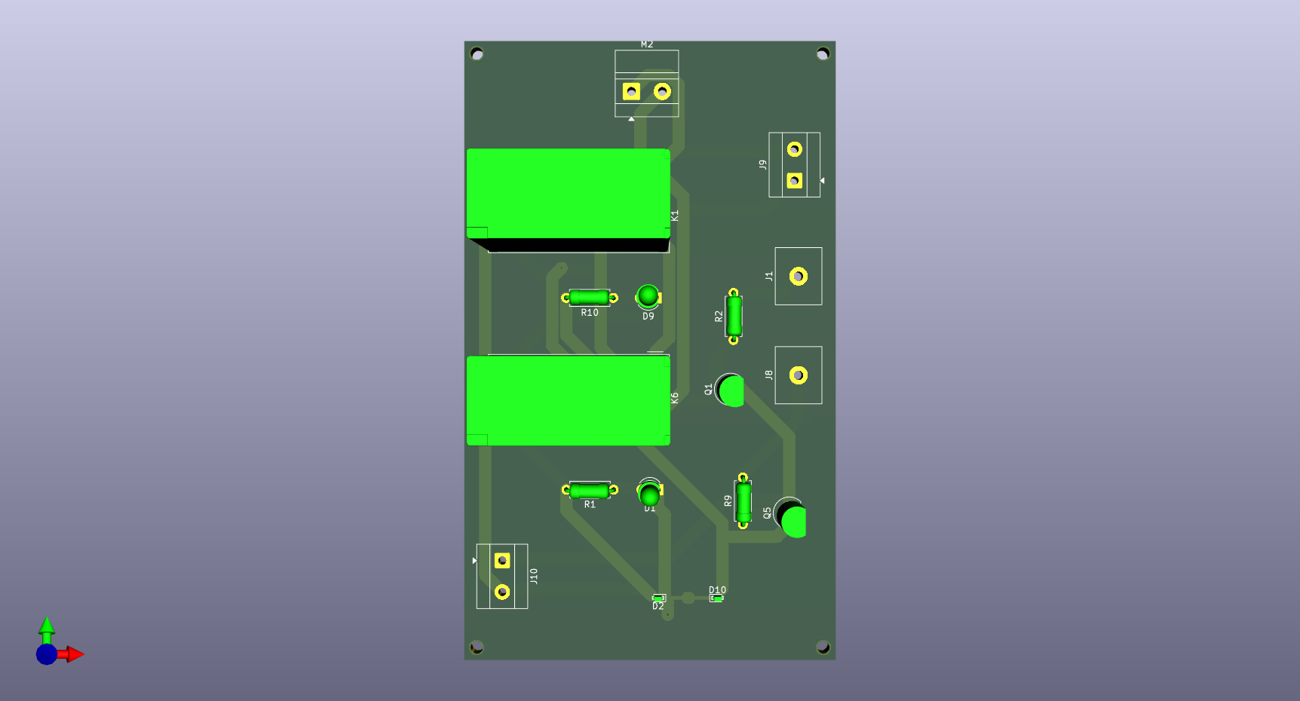
PCB
Images of the project's PCB made in KiCad (left) and then images of the Gerber viewers (right).

Slide 9

Some thechnical details
The Arduino pin cannot supply the relay coil current (~70 mA) → use an NPN transistor as a low-impedance switch
Design for saturation using forced β ≈ 10
→ IB ≥ IC / 10
Coil current: IC ≈ Vcoil / Rcoil ≈ 5 V / 70 Ω ≈ 72 mA
Therefore, IB ≈ 7.2 mA
Base resistor: RB ≈ (VOH(min) − VBE(sat)) / IB
Using VOH(min) ≈ 4.1 V, VBE(sat) ≈ 0.8 V → RB ≈ 458 Ω → choose 220+220 Ω
The overvoltage protection diode in the coil protects against voltage spikes during shutdown
A deeper dive into some information I had to look up during the project's production.

Slide 10


